Slide 1

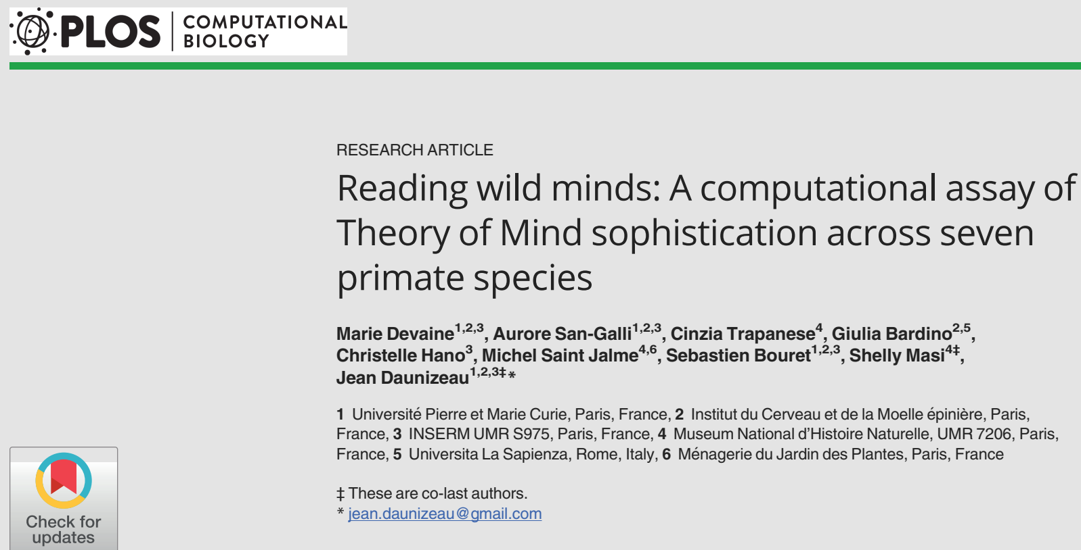
文献分享
Reporters：Chunlei Lu (Introduction & discussion)
Mingqian Guo (Methods & Results)
2022.01.19

Slide 2
Introduction
Theory of Mind (ToM)
the ability to understand others' mental states
Why humans have evolved such unusually sophisticated ToM.
Key points:
(i) proposing a computational definition of ToM
(ii) performing a comparison of seven primates species
- 1 -
Notes:
会和怎样的人合作？

Slide 3
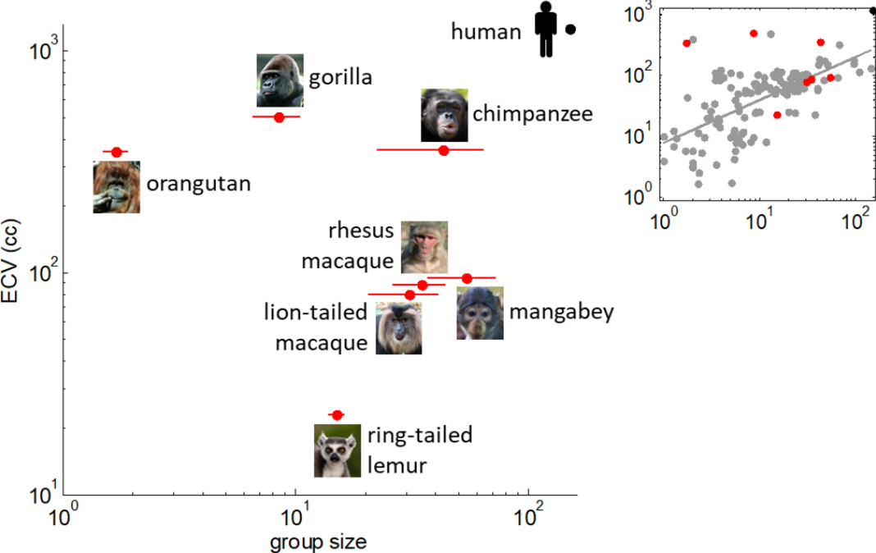
Introduction
ECV:
endocranial volume
r = 0.62, p < 10⁻⁴
N = 39,
seven primate species
r = -0.37, p = 0.41
"social brain hypothesis“ VS "scaffolding hypothesis"
- 1 -
Notes:
会和怎样的人合作？

Slide 4
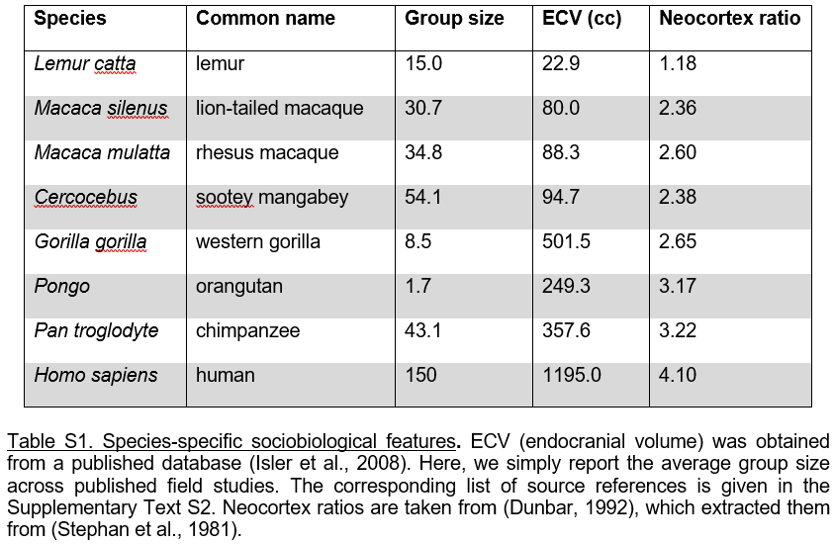
Introduction
- 1 -
Notes:
会和怎样的人合作？

Slide 5
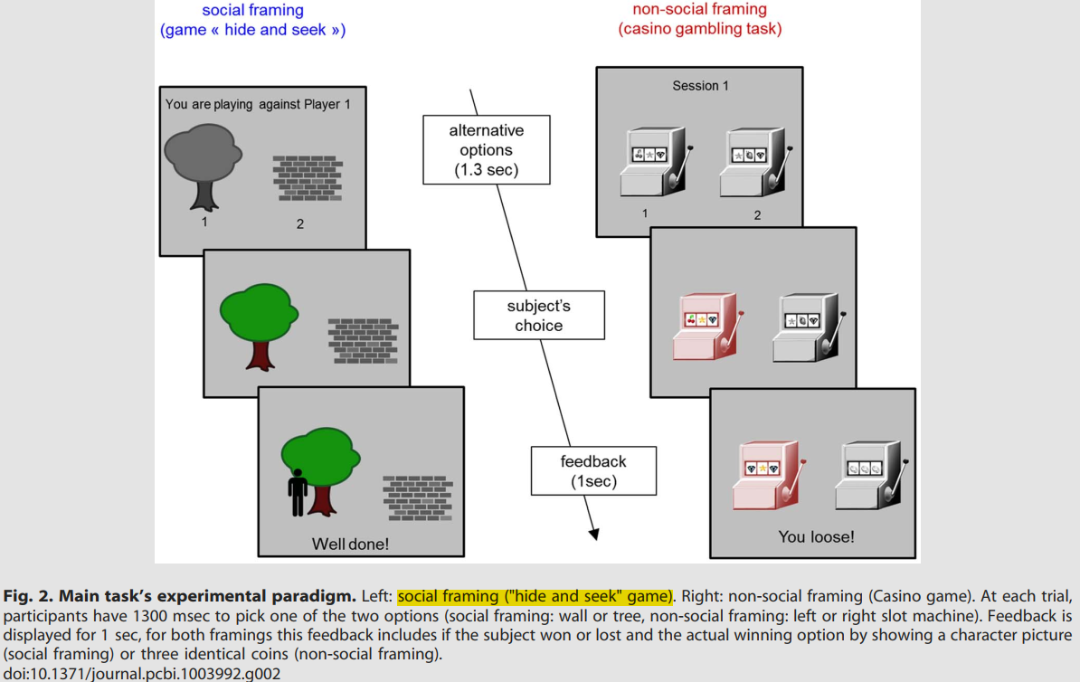
Introduction
Devaine, M., Hollard, G., & Daunizeau, J. (2014). The social Bayesian brain: does mentalizing make a difference when we learn? PLOS Computational Biology, 10(12), e1003992. doi:10.1371/journal.pcbi.1003992
- 1 -
Notes:
会和怎样的人合作？

Slide 6
Discussion
Summary：
We found that inter-species differences in ToM sophistication are predicted by differences in brain volume but not by differences in social group size.
"social brain hypothesis“ VS "scaffolding hypothesis"
- 1 -

Slide 7
Discussion
Our results provide evidence against the common-sense notion that selective pressure favoured sophisticated ToM in species that lived in bigger herds.
A few striking aspects of inter-species comparison.
Revealing the sophistication of learning styles by observing the patterns of primates’ response to the history of choices from artificial agents.
- 1 -

Slide 8
Discussion
The robustness and/or efficiency of our computational approach.
Equipped with computational means for discriminating learning styles.
How robust to changes in species’ sociobiological features our results really are.
One may challenge our computational definition of ToM
- 1 -

Slide 9
Discussion
This work provides an unprecedented computational insight onto the evolutionary roots of social intelligence.
"social brain hypothesis“ VS "scaffolding hypothesis"
Current results
Loss Win
- 1 -
Notes:
1 样本小
2 不一定正确的测量指标，比如脑容量，新皮层比例可能更合适
3 人和猴子的关系
4 也许 他们设计的实验和对应的计算建模本身就是需要更多智力 而非心理理论
5 地板效应——这个范式无法测试（猴子的）心理理论
6 7个点做回归？ 而且还不确定因变量pToM的可靠性
Q: 为什么是 F[2,58] ?

Slide 10
Arguement
1 样本小
2 不一定正确的测量指标，比如脑容量，新皮层比例可能更合适
3 人和猴子的关系测量和影响
4 也许 他们设计的实验和对应的计算建模本身就是需要更多智力 而非心理理论
5 地板效应——这个范式无法测试（猴子的）心理理论
6 7个点做回归？ 而且还不确定因变量pToM的可靠性
Q: 为什么是 F[2,58] ?
- 1 -
Notes:
1 样本小
2 不一定正确的测量指标，比如脑容量，新皮层比例可能更合适
3 人和猴子的关系
4 也许 他们设计的实验和对应的计算建模本身就是需要更多智力 而非心理理论
5 地板效应——这个范式无法测试（猴子的）心理理论
6 7个点做回归？ 而且还不确定因变量pToM的可靠性
Q: 为什么是 F[2,58] ?

Slide 11
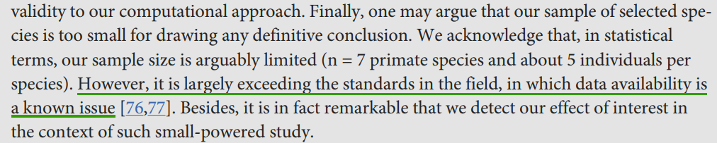
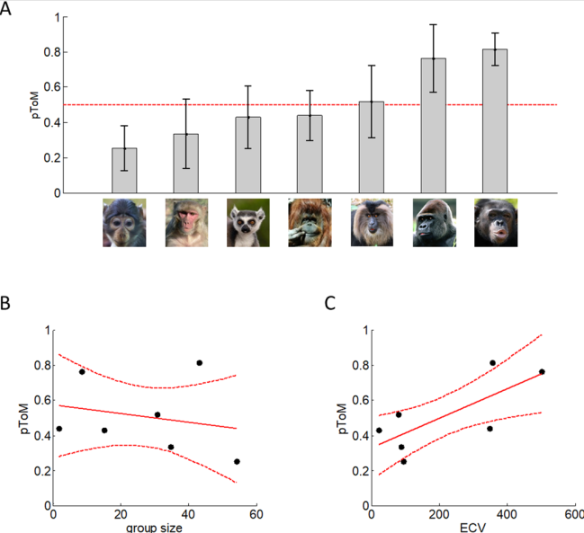
Arguement
- 1 -
Notes:
1 样本小
2 不一定正确的测量指标，比如脑容量，新皮层比例可能更合适
3 人和猴子的关系
4 也许 他们设计的实验和对应的计算建模本身就是需要更多智力 而非心理理论
5 地板效应——这个范式无法测试（猴子的）心理理论
6 7个点做回归？ 而且还不确定因变量pToM的可靠性
Q: 为什么是 F[2,58] ?

